Slide 1


April 2024

Slide 2

Today’s session.
Hi.
Enterprise Developer Workspace
We will be talking about…..

Slide 3
Agenda.
The customer.
01
The team.
02
The project.
03
…
04
Q&A
05

Slide 4

Introducing the Enterprise Developer Workspace Unlocking Developer Productivity: Empowering Developers, Accelerating Innovation
01

Slide 5
Introduction The Evolution of Software Developement
Traditional development challenges
Introduction of Enterprise Developer Workspace concept
Objectives and benefits
02

Slide 6
The Need for Change challenges in Traditional Development
Siloed environments
Manual processes
Lack of standardization
Slow time-to-market
03

Slide 7
Introducing the Enterprise Developer Workspace What is the Enterprise Developer Workspace?
Unified and standardized developement environment
Empowers developer with self-servisse capabilities
Enables automation, collaboration and innovation
04

Slide 8
Key Components Components of Enterprise Developer Workspace
Unified developement environment
Infrastructure as Code
DevOps toolchain integration
Containerization and orchestration
Security and Compliance controls
Self-services capabilities
Collaboration and knowledge sharing
05

Slide 9
Benefits Unlocking the Benefits
Improve developer productivity
Accelerate time-to-market
Enhance collaboration and innovation
Inclease security and compliance
Cost optimization and resource efficiency
06

Slide 10
Considerations for Implementation Factors to Consider
Organizational culture and change management
Skillset and training
Governance and compliance framework
Scaleability and flexbility
Integration and ecosystem compatibility
07

Slide 11
Conlusion Unlocking Potential, Driving Success
Recap of key points
Call to action for adopting Enterprise Developer Workspace
Next steps and resources for further exploration
08

Slide 12
Q&A.
09

Slide 13
Thank you.

Slide 14
3
4
5
Technologies.
Technologies.
Technologies.

Slide 15
Technologies that we use.
Feature | Impact
Infrastructure as Code. | Predictable behaviour across environments, resulting in increased quality of every software release.
Modular & scalable architectures. | Flexible solutions that can be developed and shaped as the business grows, without the need for major upfront investment.
Architecture accelerators. | Standardised Infrastructure as Code blocks with built-in configurations accelerate platform build.
High availability & disaster recovery. | Meet tougher SLAs with Increased availability and fast recovery from human errors/ natural causes.
DevOps approach. | Enables collaboration at scale while providing value increments in an agile manner and ensuring quality along the way.
5
Technologies.

Slide 16
 | Beginning | Now | Future
X | x | X | X
X | X | X | X
X | X | X | X
X | X | X | X
Factors | Factors
x | x
X (x) | x (x)

Slide 17
Example
Example
Example
1. First. xxxxx.
2. Second. xxxxx.
3. Third. xxxxx.

Slide 18

































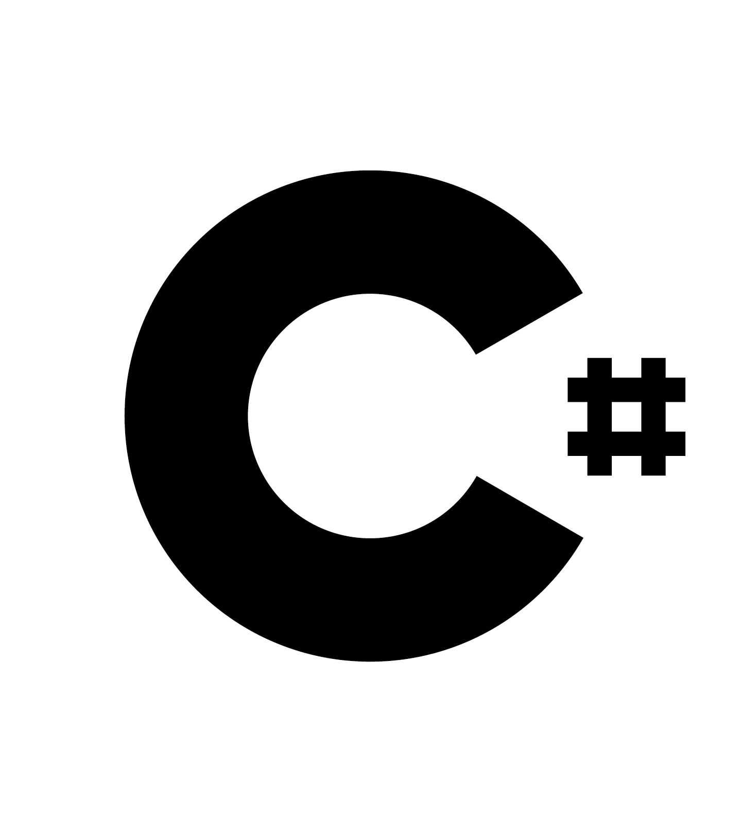




Slide 19








































Slide 20









































